Slide 1

ATLIQ HARDWARE
Consume Goods Ad-Hoc Requests Resume Challenge
Tusshar Patnaik

Slide 2
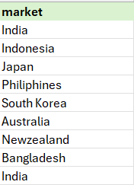
QUESTION 1: Provide the list of markets in which customer "Atliq Exclusive" operates its business in the APAC region
QUERY: SELECT market FROM dim_customer WHERE customer = "Atliq Exclusive" AND region = "APAC";
INSIGHTS:
Atliq Exclusive has established its presence in 8 countries within Asia – Pacific Region

Slide 3

QUESTION 2: What is the percentage of unique product increase in 2021 vs. 2020? The final output contains these fields, unique_products_2020, unique_products_2021, percentage_chg
QUERY: WITH x AS ( SELECT COUNT(DISTINCT product_code) AS unique_products_2020 FROM fact_sales_monthly WHERE fiscal_year = 2020 ), y AS ( SELECT COUNT(DISTINCT product_code) AS unique_products_2021 FROM fact_sales_monthly WHERE fiscal_year = 2021 ) SELECT x.unique_products_2020, y.unique_products_2021, ROUND(((y.unique_products_2021 - x.unique_products_2020)/ x.unique_products_2020)*100,2) AS percentage_chg FROM x, y;
INSIGHTS:
In FY 2020, we had a total of 245 products and in FY 2021 the number increased to 334 reflecting a growth of 36%

Slide 4
QUESTION 3: Provide a report with all the unique product counts for each segment and sort them in descending order of product counts.
The final output contains 2 fields: segment & product_count
QUERY: SELECT segment, COUNT(DISTINCT product_code) AS product_count FROM dim_product GROUP BY segment ORDER BY product_count DESC;

Slide 5
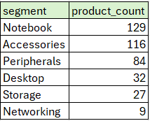
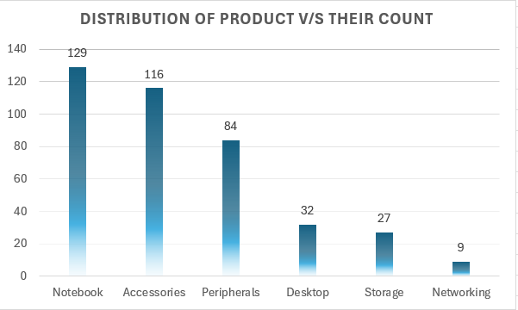
INSIGHTS:
Notebooks and other accessories has wide range of products available with Atliq Hardware
There is a strategic need to broaden the product portfolio within Desktop, Storage and Networking markets which can be achieved with trending products in these segments.

Slide 6
QUESTION 4: Which segment had the most increase in unique products in 2021 vs 2020? The final output contains these fields: segment, product_count_2020, product_count_2021 & difference
QUERY: WITH x AS ( SELECT segment, COUNT(DISTINCT product_code) AS product_count_2020 FROM dim_product p JOIN fact_sales_monthly s ON s.product_code = p.product_code WHERE fiscal_year = 2020 GROUP BY segment ), y AS ( SELECT segment, COUNT(DISTINCT product_code) AS product_count_2021 FROM dim_product p JOIN fact_sales_monthly s ON s.product_code = p.product_code WHERE fiscal_year = 2021 GROUP BY segment ) SELECT x.segment, x.product_count_2020, y.product_count_2021, (y.product_count_2021 - x.product_count_2020) AS difference FROM x JOIN y ON x.segment = y.segment ORDER BY difference DESC;

Slide 7
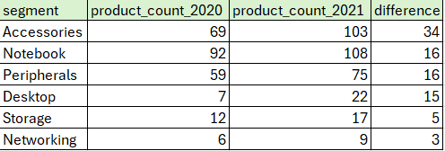
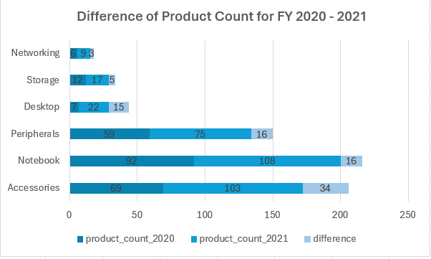
INSIGHTS:
In 2021, Atliq Hardware primarily focused on expanding its presence in the accessories market, introducing a total a 34 new accessory products to the market.

Slide 8

QUESTION 5: Get the products that have the highest and lowest manufacturing costs. The final output should contain these fields, product_code, product and manufacturing_cost
QUERY: (SELECT p.product_code, product, manufacturing_cost FROM fact_manufacturing_cost m JOIN dim_product p ON p.product_code = m.product_code ORDER BY manufacturing_cost DESC LIMIT 1) UNION (SELECT p.product_code, product, manufacturing_cost FROM fact_manufacturing_cost m JOIN dim_product p ON p.product_code = m.product_code ORDER BY manufacturing_cost ASC LIMIT 1);

Slide 9
QUESTION 6: Generate a report which contains the top 5 customers who received an average high pre_invoice_discount_pct for the fiscal year 2021 and in the Indian market. The final output contains these fields: customer_code, customer, average_discount_percentage
QUERY: SELECT c.customer_code, customer, ROUND(AVG(pre_invoice_discount_pct) * 100, 2) AS average_discount_percentage FROM dim_customer c JOIN fact_pre_invoice_deductions p ON p.customer_code = c.customer_code WHERE market = "India" AND fiscal_year = 2021 GROUP BY c.customer_code, customer;
;

Slide 10
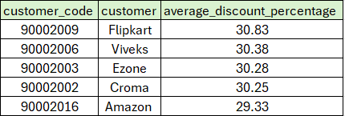
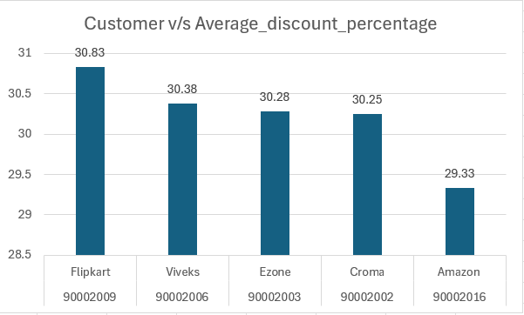
INSIGHTS:
Flipkart holds the position for highest average discounted customer in Indian Market with a pre-invoice discount percentage at 30.83% and Amazon holds 5th position in this with 29.33%

Slide 11
QUESTION 7: Get the complete report of the Gross sales amount for the customer “Atliq Exclusive” for each month . This analysis helps to get an idea of low and high-performing months and take strategic decisions. The final report contains these columns: Month Year Gross sales Amount
QUERY: SELECT monthname(date) AS Months, g.fiscal_year, ROUND(SUM(g.gross_price * s.sold_quantity), 2) AS gross_sales_amount FROM fact_gross_price g JOIN fact_sales_monthly s ON s.product_code = g.product_code AND s.fiscal_year = g.fiscal_year JOIN dim_customer c ON c.customer_code = s.customer_code WHERE customer = "Atliq Exclusive" GROUP BY fiscal_year, Months -- GROUP BY numerical month for proper sorting, keep Months for display ORDER BY fiscal_year -- ORDER BY numerical month for chronological order
;

Slide 12
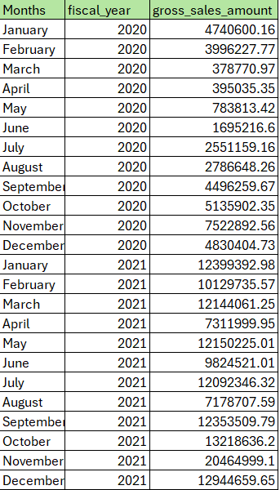
INSIGHTS:
Atiq's Exclusive hit its sales peak in November 2020, marking the highest sales ever recorded.
March 2020 experienced the lowest sales for the company.
The sales decline from March to August 2020 was due to the impact of COVID-19.
Despite the challenges, there's optimism as sales have consistently rebounded since the pandemic, surpassing 2020 levels.

Slide 13
QUESTION 8: In which quarter of 2020, got the maximum total_sold_quantity? The final output contains these fields sorted by the total_sold_quantity, Quarter total_sold_quantity
QUERY: SELECT
CASE
WHEN date BETWEEN '2019-09-01' AND '2019-11-01' THEN 'Q1'
WHEN date BETWEEN '2019-12-01' AND '2020-02-01' THEN 'Q2'
WHEN date BETWEEN '2020-03-01' AND '2020-05-01' THEN 'Q3'
WHEN date BETWEEN '2020-06-01' AND '2020-08-01' THEN 'Q4'
END AS quarters,
ROUND(SUM(sold_quantity)/1000000,2) AS total_sold_quantity_in_mln
FROM fact_sales_monthly
WHERE fiscal_year=2020
GROUP BY quarters
ORDER BY total_sold_quantity_in_mln DESC;
;

Slide 14
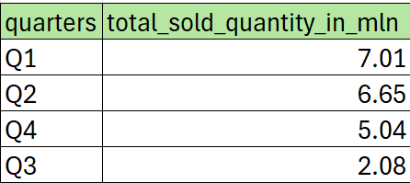
INSIGHTS:
In the 3rd quarter of fiscal year (March, April & May), amidst the peak of COVID-19 and widespread lockdowns, the sold quantity surged to 2.1 million units.
Notably, there was a remarkable demand for computer accessories during this period, driven by a surge in online coursework among students.

Slide 15
QUESTION 9: Which channel helped to bring more gross sales in the fiscal year 2021 and the percentage of contribution? The final output contains these fields, channel gross_sales_mln percentage
QUERY:
WITH cte AS ( SELECT channel, ROUND(SUM(gross_price*sold_quantity)/1000000,2) as gross_sales_mln FROM fact_sales_monthly s JOIN fact_gross_price g USING (product_code, fiscal_year) JOIN dim_customer c USING (customer_code) WHERE fiscal_year = 2021 GROUP BY channel ) SELECT channel, gross_sales_mln, ROUND((gross_sales_mln*100)/SUM(gross_sales_mln) over(), 2) as pct FROM cte ORDER by pct desc;
;

Slide 16
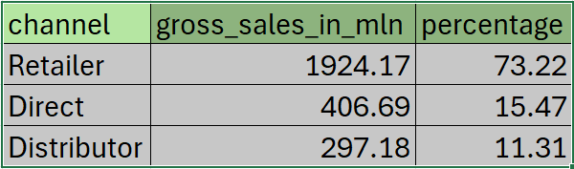
INSIGHTS:
Retailers accounted for a significant 73% of Atliq's total sales, representing most of its overall sales.
In contrast, sales through direct and distributor channels constituted a comparatively smaller portion of the total revenue.

Slide 17
QUESTION 10: Get the Top 3 products in each division that have a high total_sold_quantity in the fiscal_year 2021?
QUERY:
WITH x AS ( SELECT division, p.product_code, p.product, SUM(sold_quantity) AS total_sold_quantity, RANK() OVER(PARTITION BY division ORDER BY SUM(sold_quantity) DESC) AS rank_order FROM dim_product p JOIN fact_sales_monthly s USING (product_code) JOIN fact_gross_price g USING (product_code, fiscal_year) WHERE fiscal_year = 2021 GROUP BY division, product_code, product ORDER BY total_sold_quantity DESC ) SELECT division, product_code, product, total_sold_quantity, rank_order FROM x WHERE rank_order <= 3;
;

Slide 18



INSIGHTS:
1. The three best-selling products in P&A were Pen Mouse
2. The three best-selling products in PC were laptops
3. The three best-selling products in N&S were Pen drives

